Slide 1
EXPLORING DIFFERENT INTELLIGENCES
See what's possible!
September 2016
Notes:
This workshop is about people as resources not processes/methodologies.
SHOW OF HANDS
How many know about Emotional Intelligence?
Social Intelligence?
Relationship System Intelligence?

Slide 2
Wheel of Fortune
M_N_M_Z_
D_S_R_C_I_N
M_X_M_Z_
V_L_E
Notes:
Efficiency
Working with People
Smooth sailing
Getting to Results – quickly and painless as possible
Collaboration
Distractions often about relationships, personalities, difference of opinions, moods, group dynamics

Slide 3
Wheel of Fortune
MINIMIZE
DISTRACTION
MAXIMIZE
VALUE

Slide 4
Remember the last significant team you worked with…
What were the team dynamics like? What's one adjective to describe it ?
How do/did you FEEL about the dynamics of that team?
Notes:
1.
Do you think the group worked well together?
Were the results achieved?
Would you work with that group again?
What are your thoughts?
What is an adjective you would use to describe it best: Reliable Self-starter Loyal Studious Attentive Conscientious Industrious Persistent Dynamic Energetic Enterprising Enthusiastic Aggressive Consistent Organized Professional Methodical Skillful Passionate
Share with your neibour for 2 mins each
2.
How did you feel walking in a meeting with this group?
When you went home at night, how did you feel? What FEELINGS did you have about the team? It made me feel….(slide?)
Need a little help?

Slide 5
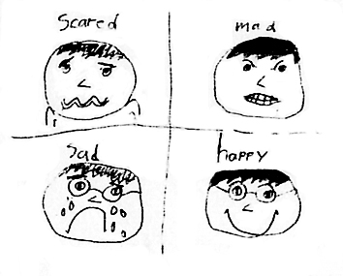
Emotions
Notes:
Four basic categories of emotions
Can all of these over a period of working with a group, that’s normal?
Overall what would be the emotion that best describe your feeling about working with this group
Were you mad? Confused, frustrated, angry, bitter, agravated
Sad – depressed, disappointed, unhappy, down, the blues
Scared – anxious, apprehensive, worried, nervous, fearful, panic
Happy – satisfied, glad, pleased, content

Slide 6
EMOTIONAL INTELLIGENCE
Equips individuals to master their internal life.
Anywhere, anytime, every time.
Accurate self-assessment.
And….self management e.g. adaptability
Notes:
KNOWING ME/IN RELATIONSHIP WITH SELF

Slide 7
SOCIAL INTELLIGENCE
Awareness of emotional states of others
Engenders empathy
Managing relationships
Influence, deal with conflict, build bonds, teamwork and collaboration
Notes:
KNOWING YOU AND ME

Slide 8
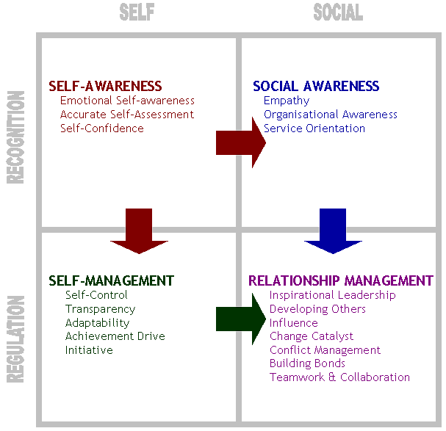
EMOTIONAL INTELLIGENCE QUADRANT
Notes:
We have a Handout

Slide 9
RELATIONSHIP SYSTEMS INTELLIGENCE (RSI)
Awareness of emotional states of the “team” aka personality
What's the feeling/energy between us?
And IT changes all the time
We call this the EMOTIONAL FIELD (RSI)
Notes:
KNOWING IT
What is the IT? IT is the culture, the vibe, the atmosphere, energy.
You do not see IT but you feel IT.
As you reflect when you leave a group. You will think, well that was Fun, INTERESTING or NEVER AGAIN
There is ME (EI) and YOU (SI) and us together is IT. Me with someone else would be a different IT and would have a different personality
Now add a 3rd person, the personality of IT will shift and now a 4th, a 5th, etc. you get the point
This personality of each TEAMS/IT is unique
Link back to the 4 feelings – Mad, Sad, Happy and Scared
For example, maybe not every single person is SCARED but the overall atmosphere of the TEAM is apprehensive, concerned, anxious, etc. due to varying circumstances – loss of resources, change in deadlines, loss of a team member, etc.
WHAT DO YOU WITH THAT?

Slide 10
WHAT CAN YOU DO WITH THE AWARENESS OF THE EMOTIONAL FIELD (EF)?

Slide 11
Reading the Emotional Field
If you feel something about the group:
surface it
check it out
start a conversation
see where it leads
Notes:
Do not get attached to your perception or anyone’s perception
What is important is that the team discuss/converse about what is happening and decide what to do with this new information
It is important to create and maintain a safe and non-judgmental environment

Slide 12
AGILE VALUES
Communication
Simplicity
Feed-back
Courage
Humility
Servant Leader
Notes:
Reading the EF is helpful in upholding the Original Agile Manifesto Values
Individuals and interactions over processes and tools
Working software over comprehensive documentation
Customer collaboration over contract negotiation
Responding to change over following a plan
You need EF for each ne of these

Slide 13
Benefits of RSI (EF)
Improved team relationships and communications
Enhanced team identity, productivity and retention.
Constructive conflict management, rapid resolution and productive outcomes
Increased positivity within the work environment
Increased creative potential for the team
Notes:
In an Agile environment you engage with each other in a way that does not happen in any other development culture. The Retrospective step purpose is to reflect on how we work together. Reading the EF is important information so that how we work together to add value is always at the centre of our interactions.
Agile is about creating healthy tensions by having and hearing different views, different purposes.
The Scrum Master/Agile Coach intentionally generates dynamic tensions in order to get the best value for the product.

Slide 14
Comparing IQ and EQ
 | IQ | EQ
Stands for | Intelligence Quotient | Emotional Quotient (aka emotional intelligence)
Definition | An intelligence quotient (IQ) is a score derived from one of several standardized tests designed to assess intelligence. | Emotional quotient (EQ) or emotional intelligence is the ability to identify, assess, and control the emotions of oneself, of others, and of groups.
Abilities | Measures person’s ability to learn, understand and apply information to skills, logical reasoning, word comprehension, math skills, abstract and spatial thinking, filter irrelevant information. | Identify, evaluate, control and express emotions one’s own emotions; perceive, and assess others' emotions; use emotions to facilitate thinking, understand emotional meanings.
In the workplace | Success with challenging tasks, ability to analyze and connect the dots, research and development. | Teamwork, leadership, successful relations, service orientation, initiative, collaboration.
Identifies | Highly capable or gifted individuals, individuals with mental challenges and special needs. | Leaders, team-players, individuals who best work alone, individuals with social challenges.
Origin | 1883, English statistician Francis Galton's paper "Inquiries into Human Faculty and Its Development" First application came in French psychologist Alfred Binet's 1905 test to assess school children in France. | 1985, Wayne Payne's doctoral thesis "A Study of Emotion: Developing Emotional Intelligence" Popular use came in Daniel Goleman's 1995 book "Emotional Intelligence - Why it can matter more than IQ"
Popular Tests | Stanford-Binet test; Wechsler; Woodcock-Johnson Tests of Cognitive Abilities. | Mayer-Salovey-Caruso Test (emotion-based problem-solving tasks); Daniel Goleman model Score (based on emotional competencies).

Slide 15
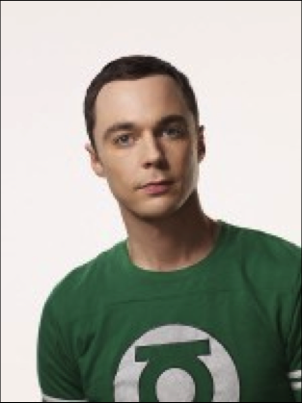

Slide 16
Five Principles of RSI (EF)
Each Relationship System has its own unique entity
Every member of a Relationship System is a voice of the system
Relationship Systems are naturally intelligent, generative and creative
Roles belong to the system, not to the individuals
Relationship systems are in a constant state of emergence

Slide 17
How can you make
your self-organising teams
AWESOME?

